Slide 1
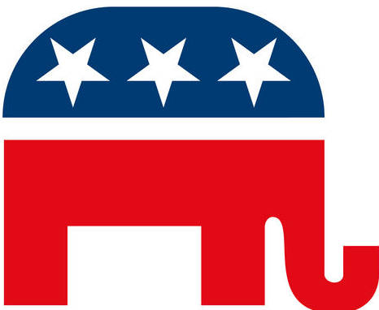
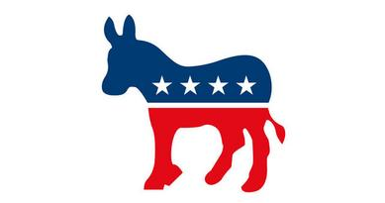
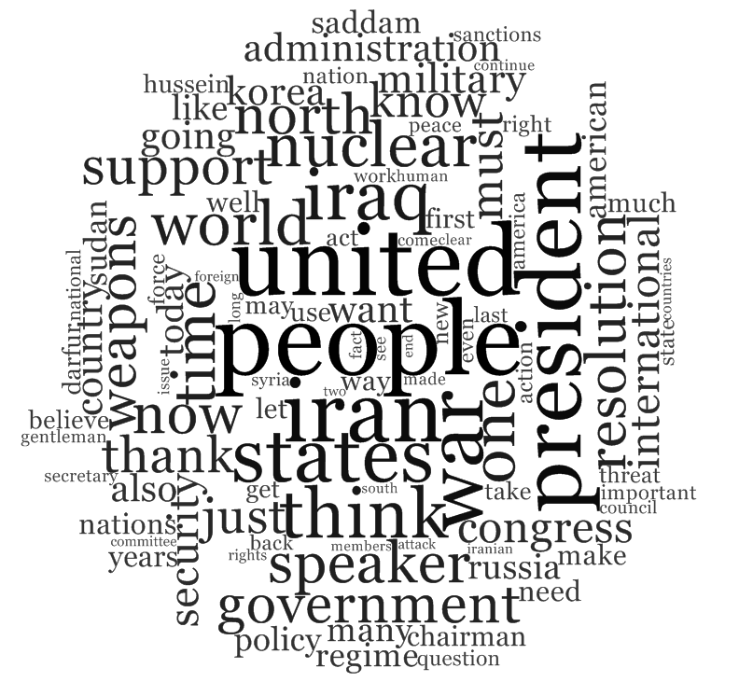
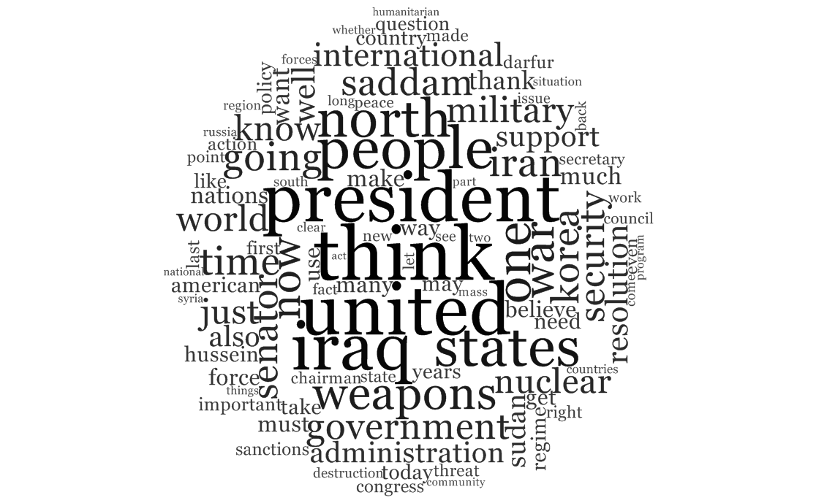
The Use of Moral Language in Congressional Foreign Policy Discourse
Kayla N. Jordan, Jahnavi R. Delmonico, and Erin M. Buchanan
Missouri State University
Introduction
Methods
Results
Moral foundations theory (MFT) expands the moral domain to include more than justice concerns.
Moral judgments as intuitions (Haidt, 2001)
5 moral foundations:
harm/care,
fairness/reciprocity,
ingroup/loyalty,
authority/respect, and
purity/sanctity.
Liberals tend to only consider the harm/care and fairness/reciprocity foundations whereas conservatives tend to consider all five foundations (Federico, Weber, Ergun, & Hunt, 2013; Graham, Haidt, & Nosek, 2009; Graham, Nosek, & Haidt, 2012).
Moral foundations dictionary (Graham et al., 2009).
The purpose of the current study is to explore how moral language is used in the U.S. Congress in reference to foreign policy decisions, specifically decisions regarding conflict.
Congressional speeches from the Congressional Record available online from the U.S. Government Printing Office.
Congressional speeches from foreign affairs committee hearings.
Time frame: January 1998 to August 2013
Topics: U.S. foreign relations with the following nations: Iraq, Iran, Kosovo, Libya, Russia, North Korea, Syria, Sudan, and Afghanistan.
For Iraq, Kosovo, and Afghanistan, only speeches made before Congressional approval of military action were included.
N = 1877 speeches
Venues: 449 Senate speeches, 793 House speeches, 329 Senate hearings speeches, and 306 House hearings speeches.
Topics: 525 Iraq, 116 Afghanistan, 323 Iran, 161 North Korea, 138 Russia, 116 Syria, 267 Sudan, 82 Kosovo, and 149 Libya.
Word count for the speeches was
M = 1053.35, SD = 1189.24)
Min = 200, Max = 21,329
Bayesian t- tests were conducted to test for party differences for each moral foundation.
For harm and fairness, Democrats were hypothesized to use more words than Republican. For ingroup, authority, and purity, Republicans more words than Democrats.
Non-informed cauchy priors were used.
Table 1
Word Frequencies
Total Number of Words | 2,026,243
Total Number of Harm Words Used | 7838 (.387%)
Total Number of Fairness Words Used | 1976 (.098%)
Total Number of Ingroup Words Used | 2985 (.147%)
Total Number of Authority Words Used | 4057 (.200%)
Total Number of Purity Words Used | 717 (.035%)
Figure 1
Bayesian Mean Estimates
n=55
n=206
Discussion
No significant party differences were found for any of the five moral foundations.
Given these lack of differences, the utility, and possibly the validity, of the moral foundations dictionary is questionable.
Further research is necessary to determine how best to measure morality in language.
Contact: Kayla Jordan (kaylajordan91@gmail.com) or Erin Buchanan (erinbuchanan@missouristate.edu)

